Slide 1


What is the future of international travel?
汇报人：周高升
2
0
2
1

Slide 2

Development of international travel
COVID-19 and international travel
Diversified ways of international travel
Purposes of international travel

Slide 3

01
Development of international travel

Slide 4
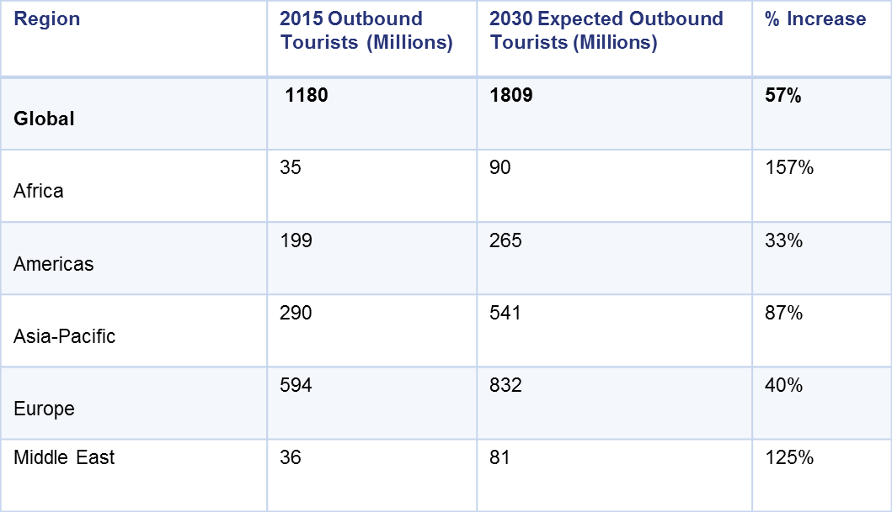
Development of international travel
the development of international travel
According to the data from UNWTO,the travel and tourism industry has grown dramatically in the past decades, reaching nearly 1.2 billion international arrivals in 2015, compared to 25 million in 1950. That’s a growth of 4,700% – and this number is only expected to get bigger, reaching 1.8 billion international arrivals by 2030. You might be surprised, but it’s one of the fastest growing economic sectors in the world.

Slide 5
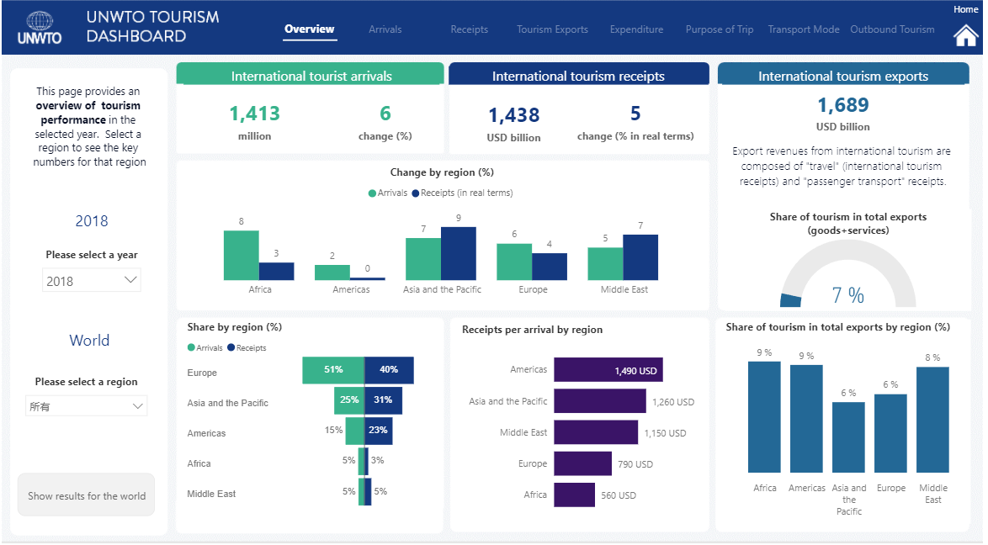
Development of international travel
This is a summary table about the international travel situation in 2018.As we can see, the total number of international tourists in this year reached 1413 billion,with an annual growth rate of 6% .And the total international tourism receipts reached 1438 billion dollars with an annual growth rate of 5%.

Slide 6
Development of international travel
The world's tourism exports account for seven percent of total global exports.
Of all the regions, Europe accounted for the largest share of international tourist arrivals, accounting for more than half of global arrivals. The Asia-Pacific region has the second largest share, with the Middle East and Africa having the fewest.

Slide 7
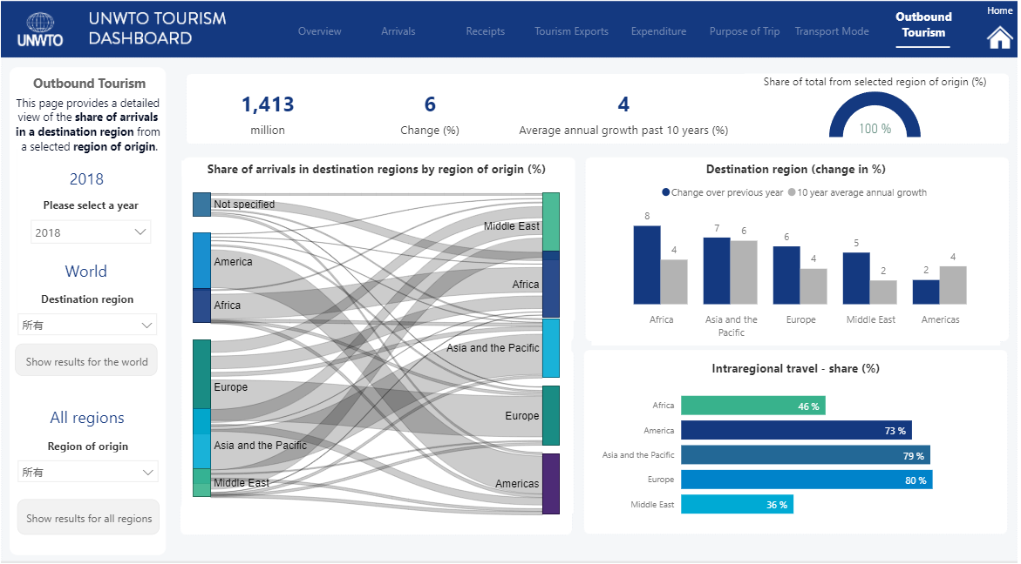
Development of international travel
This is a table about the development of different region’s international travel in 2018. And we can easily find that the number of tourists in each region are increasing year by year. Africa and Asia Pacific are the fastest growing regions.

Slide 8
02
COVID-19 and international travel

Slide 9
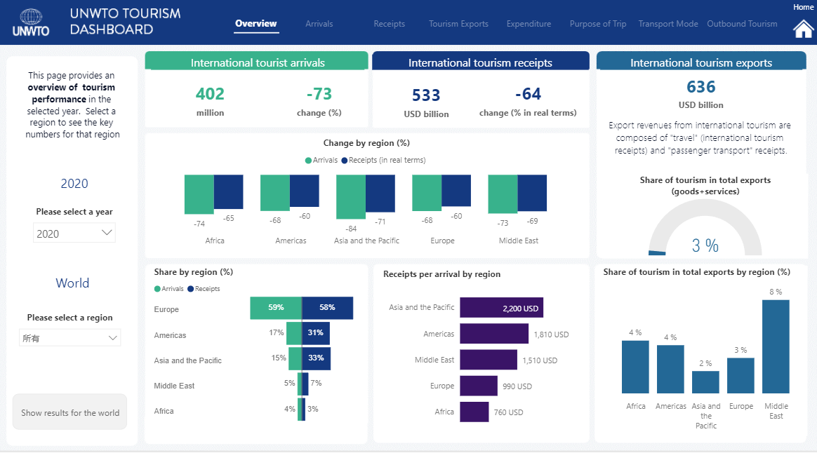
COVID-19 and international travel
This table shows the data of global international tourism in 2020. In comparison with the 2018 figures, it is easy to see that both the number of tourists and the revenue from tourism around the world fell significantly.
COVID-19 has dealt a fatal blow to the tourism industry. Governments and people voluntarily quarantined at home to avoid the spread of COVID-19.

Slide 10
COVID-19 and international travel
However, we can expect that the impact of COVID-19 will only be temporary. Because people's strong demand for travel will not disappear because of temporary repression. During the National Day of 2021,the number of tourists reached 515 million in China, returning to 70% of the same period before COVID-19.
Therefore, we can be confident that the situation of international tourism will improve after COVID-19 ends.

Slide 11
03
Diversified ways of international travel

Slide 12
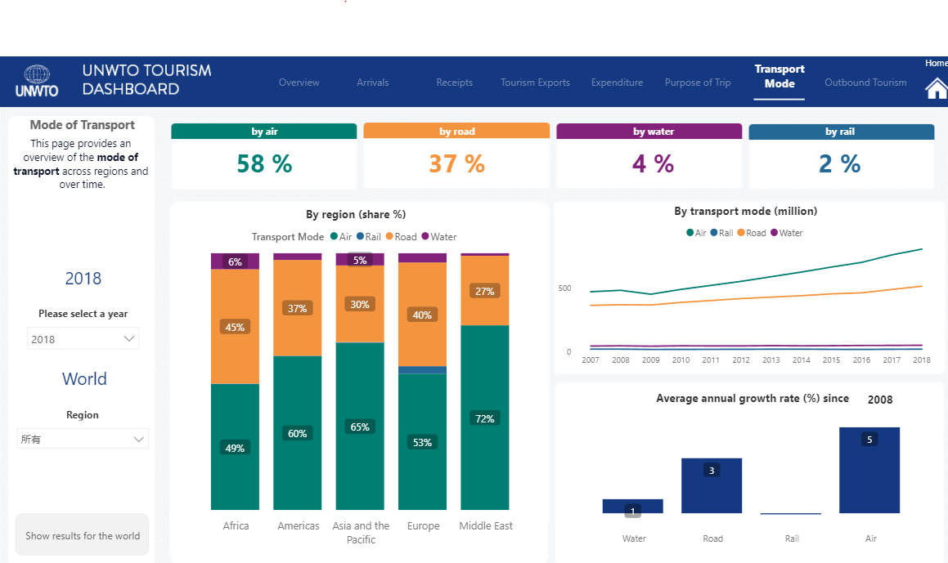
Diversified ways of international travel
This chart shows the data about the different modes of transportation people use to travel internationally. It is obvious that air and road are the main modes of international travel. Only very few people travel internationally by rail or sea.And the proportion of air and road travel continues to rise year by year.We can easily conclude that air travel will be the main way for people to travel internationally.

Slide 13
04
Purposes of international travel

Slide 14
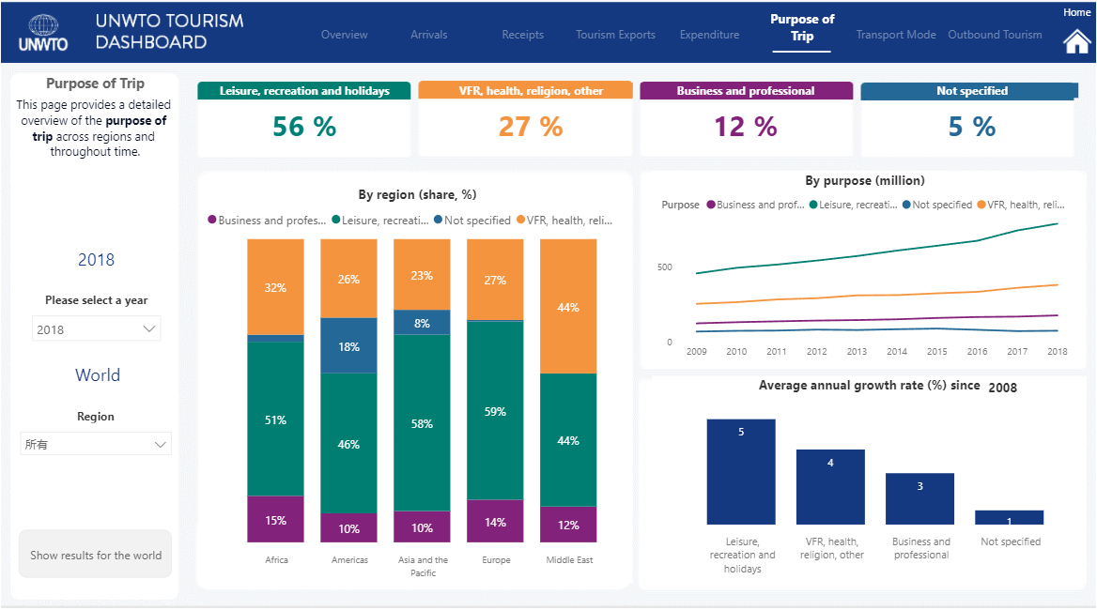
Purposes of international travel
This chart shows the data about the different mpurposes for international travel. Among them, the most important reason for people to travel abroad is the need for relaxation, holidays and festivals, followed by the need for health and religious belief. As people's living standards improve, more and more people travel internationally for personal needs such as relaxation.

Slide 15
THANKS！
2
0
2
1

